Slide 1


Slide 2
LIGHT EMITTING DIODE
(LEDs)
TOPIC

Slide 3
PRESENTED BY AND DESIGNED
Presentation Point check out link below for more presentations (www.presentationpoint.yolasite.com)
IDEA BY:
FUTURE IT (www.futureit.yolasite.com)
SUPPORTED BY:
www.exploretomorrow.blogspot.com

Slide 4
WHY I CHOSE THIS TOPIC?
Computer Science Students
Unique Topic

Slide 5
WHY CHOSE TOPIC?
21st century the most promising high-tech areas.
Lighting market in the face of tremendous temptation.
Millions of dollars are invested, but the scale of investment in the future will continue to increase.

Slide 6
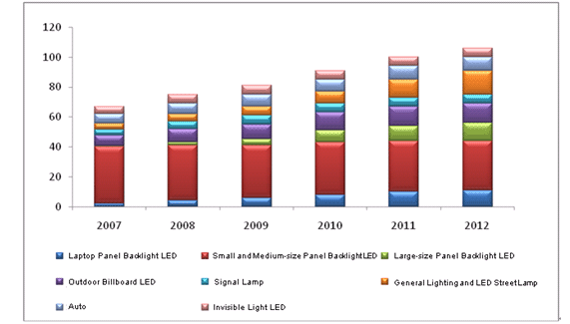
LED Market Downstream Distribution and Market Size, 2007-2012E
Source: ResearchInChina

Slide 7
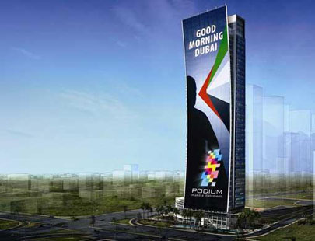

Slide 8
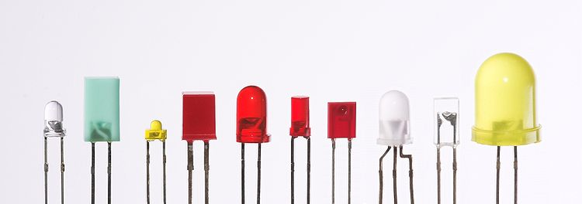
HISTORY OF LED’s

Slide 9
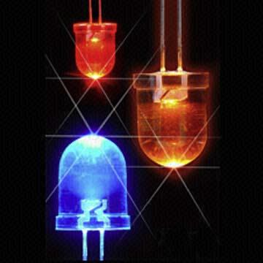
What is LED?
Semiconductors bring quality
to light!
LED’s stand for Light Emitting Diode, which provide a fairly ok level of lightning at the same time required a lot less power in order to operate.
Now a days they are being used in different type of electronic devices. For example LAPTOP, Monitors, Emergency lights etc.

Slide 10
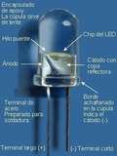
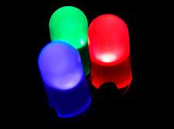
WHAT IS L.E.D.?
Light-Emitting Diodes -- T.L.A.
  Light (To Glow)
  Emitting (T0 Extract)
  Diodes (Type of electronic circuit)

Slide 11

HISTORY OF LED’s
The first person to experiment and come up with a Light Emitting solid–state Diode was a British scientist by the name H.J ROUND in 1907.
  However in the same time span different Russian researchers also work on that.

Slide 12
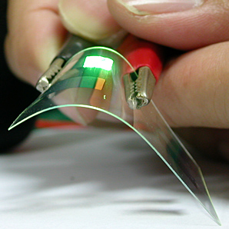
Development of LED’s
The first practical visible-spectrum (red) LED was developed in 1962 by a researched for the General Electronic Company, Nick Holonyak JR, who is officially credited as the “ Father of the Light Emitting Diode”.
He was the student of the Nobel prize winner John Bardeen, the developer of the transistors, develop LED’s while working for General Electronics.

Slide 13
FIRST COMMERCIAL USE IN 1960’S
Even if the first working model was developed in 1962, the first LED becomes commercially available in lates 1960’s, and were in red.
At the time they were used as replacemants for incandesent indicators, and in seven segments displays.

Slide 14
DEVELOPMENT OF COLOR LED’S IN 1970’S:
Throughout the 1970’s.the development in LED technology led to appearance of additional colors and wave lengths.
The reliability of LEDs was still a pretty major issue, mainly due to the fact that LED assemblies were manufactured by hand.

Slide 15
LED TECHNOLOGY IN 1980’s:
The second major leap forward in LED technology occurred in the 1980’s, with the development of GaAIAS(galium aluminum arsenide) material.
GaAIAS(galium aluminum arsenide) helped LEDs deliver a brightness level ten times bigger then that generated by previous material.

Slide 16
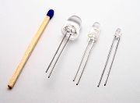
LED TECHNOLOGY IN 1980’s:
This development increase the use of LEDs in the daily life like, bar codes, scanners, fiber optic data transmission.
GaAIAS (gallium aluminum arsenide) material was still far from being perfect, since it was only available in a Red 660nm wavelength.

Slide 17


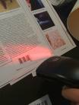

LED TECHNOLOGY IN 1980’s:
Laser development in LEDs:
In order to overcome some of the issues which were occurring earlier in late 1980s new development was made named as laser diodes.
In GaAIP(Indium Gallium Aluminum phosphate) visible LEDs, which offered a higher level of versatility, with the size of the energy the colors was also adjusted.

Slide 18
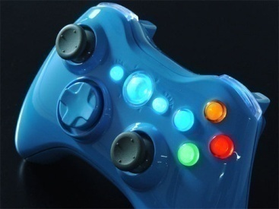

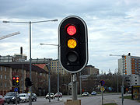
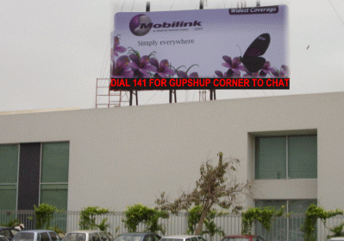
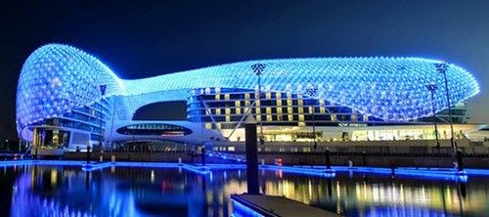
LEDs IN OUR DAILY LIFE
Billboards
Computer part
Other electronic devices
  Lamps
  Emergency lights
  Trafic signals

Slide 19
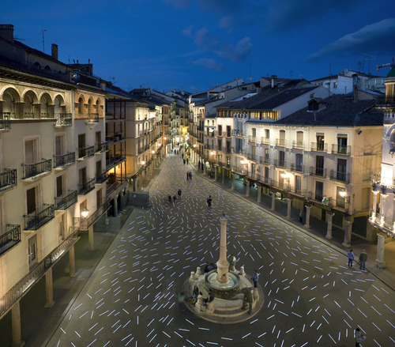
PRESENT & FUTURE

Slide 20
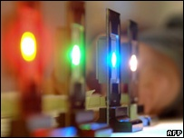
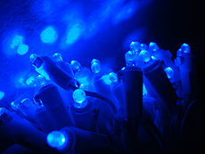
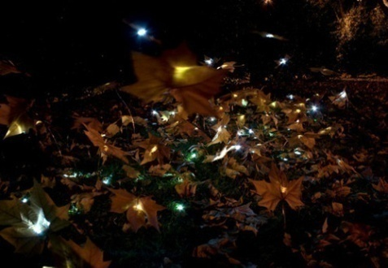
PRESENT
Monochrome Indicators
Emerging Applications
Now & the Future
Ultraviolet & blue leds
White leds
Organic light emiting diode (OLEDS)
Led Panels
Led Application

Slide 21
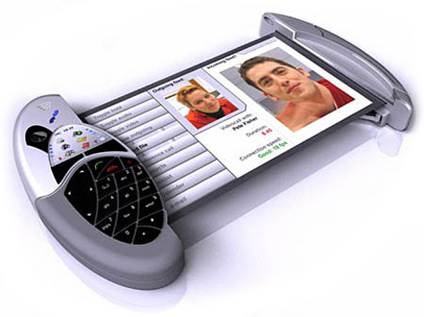
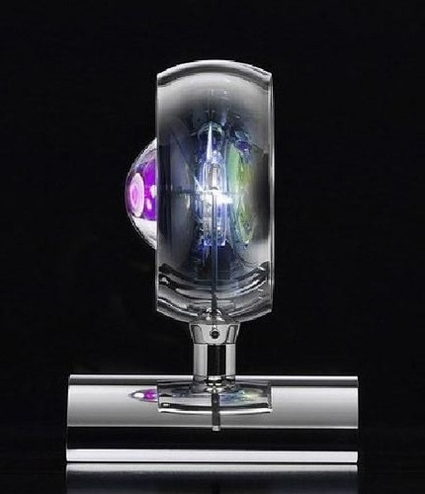

Monochrome
  Traffic lights, automotive, exit signs etc
  Portable appliances, cell phones, PDAs
  Signage
  Direct view displays; video screens

Slide 22
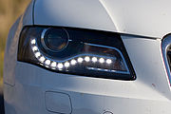
Emerging Application
  Transportation: marine, auto, aviation etc.
  Lighting niches

Slide 23
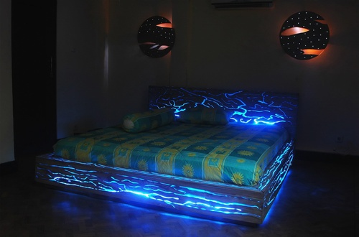
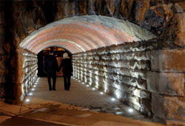
Now & Future
  General Illumination
  Evolution of the Use of LEDs Source: Ecolux, nasdaq, Daimler, Gelcorec

Slide 24
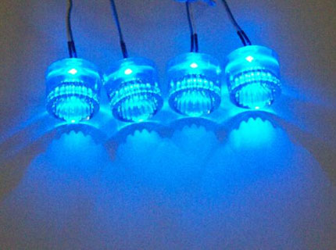
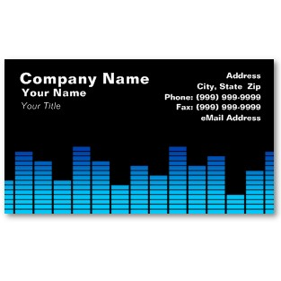
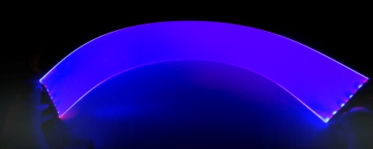
Ultravoilet & Blue LEDs
LEDs are based on the wide band gap semiconductors GaN (gallium nitride) and InGaN (indium gallium nitride).
They can be added to existing red and green LEDs to produce the impression of white light
these devices were too feeble to be of much practical use .
Ultraviolet LEDs are becoming available on the market, in a range of wavelengths

Slide 25
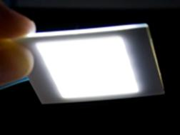
White LEDs
The newest method is based on homoepitaxially grown zinc selenide (ZnSe) on a ZnSe substrate.
A new technique ,involves coating a blue LED with quantum dots that glow white in response to the blue light from the LED.

Slide 26
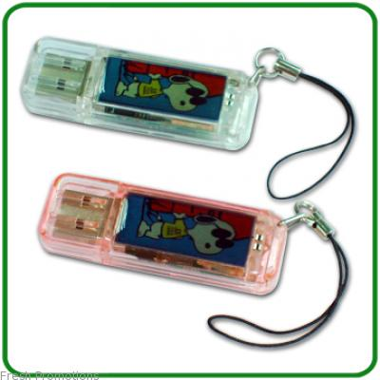
Organic light emitting diodes (OLEDs)
If the emitting layer material of an LED is an organic compound, it is known as an Organic Light Emitting Diode (OLEDs)
Crystalline phase material is known as PLEDs.
Polymer materials can be flexible or known as FLEDs.
Used to produce visual displays for portable electronic devices.

Slide 27
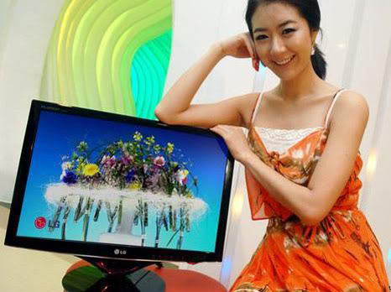
LEDs Panel
There are two types of LED panels: conventional, using discrete LEDs, and surface mounted device (SMD) panels.
Most outdoor screens and some indoor screens are built around discrete LEDs, also known as individually mounted LEDs
Most indoor screens on the market are built using SMD technology
An SMD pixel consists of red, green, and blue diodes on a chipset, which is then mounted on the driver PC board

Slide 28
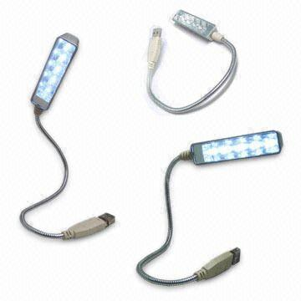
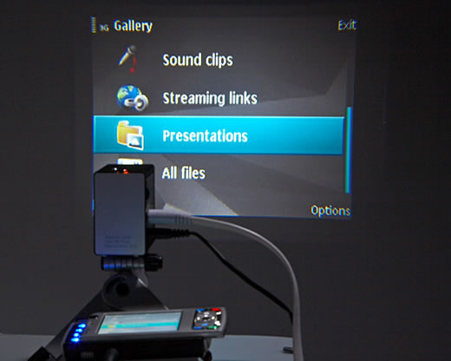
LEDs Application
Architectural lighting
Status indicators on all sorts of equipment
Traffic lights and signals
strobed illumination.
Exit signs
Motorcycle and Bicycle lights
Railroad crossing signals
Continuity indicators
Elevator Push Button Lighting

Slide 29
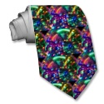
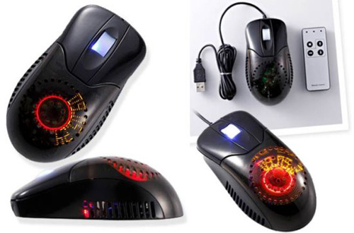
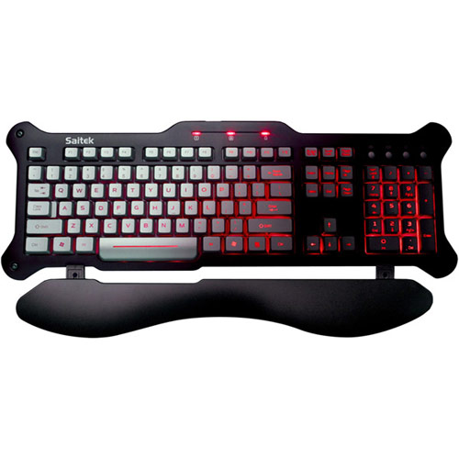
LEDs Application
Light bulb
Lanterns
Computers, for hard drive activity and power on.
Backlighting for LCD televisions and displays.
Movement sensors, for example in optical computer mice
In dot matrix arrangements for displaying messages
Lumalive, a photonic textile
Light bars on emergency vehicles.

Slide 30

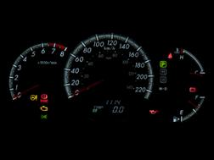
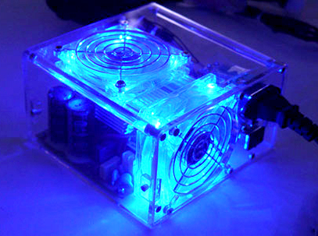
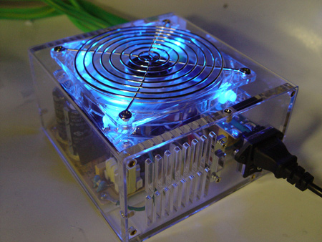
LEDs Application
Toys and recreational sporting goods, such as the Flashlight
Light source for machine vision systems, requiring bright, focused, homogeneous and possibly
Remote controls, such as for TVs and VCRs, often use infrared LEDs
In optical fiber and Free Space Optics communications
Custom computers feature LED accent lighting to draw attention to a given component.

Slide 31
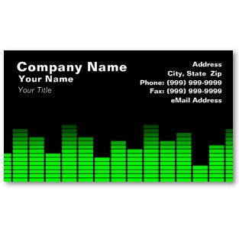
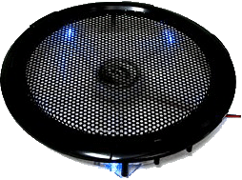
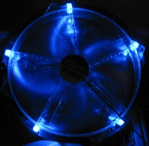
LEDs Application
Red or yellow LEDs are used in indicator and alphanumeric displays in environments where night vision must be retained.
Thin, lightweight message displays at airports and railway stations.
Flashlights, including some mechanically powered models.
Red, yellow, green, and blue LEDs can be used for model railroading applications

Slide 32
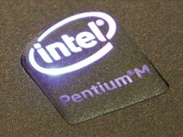
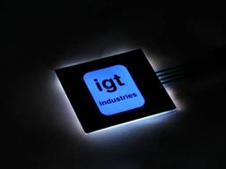


LEDs Application
LED phototherapy for acne using blue or red LEDs has been proven to significantly reduce acne over a 3 month period.
Many computer manufactuers use LEDs to tell the user its current state.

Slide 33
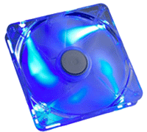
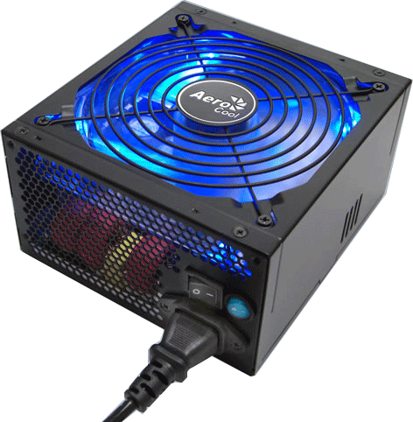
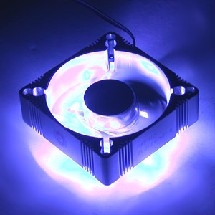
Light source for machine vision system
Machine vision systems often require bright and homogeneous illumination
compared to signaling applications.
LEDs can be easily strobed (in the microsecond range and below) and synchronized
LEDs come in several different colors and wavelengths

Slide 34
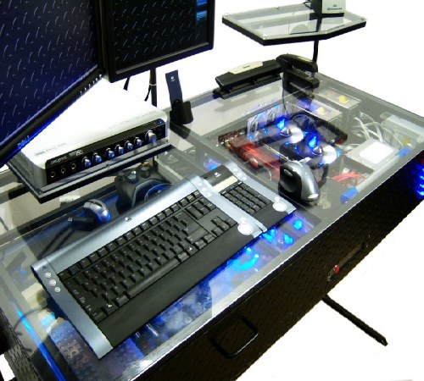
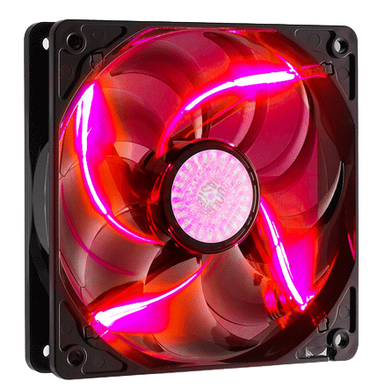
Light source for machine vision system
LEDs usually operate at comparatively low working temperatures, simplifying heat management and dissipation
LED sources can be shaped in several main configurations

Slide 35
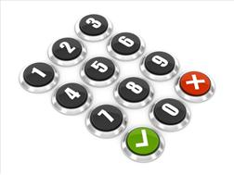
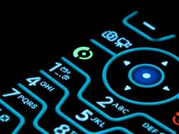
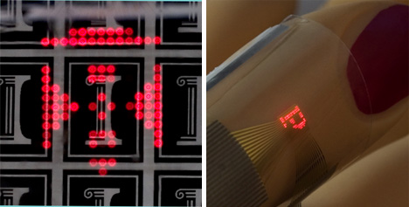
MULTI TOUCH SENSING LEDS
They can also be used for photo detection.
These properties have been known as bidirectional LED matrices have been proposed as a method of touch-sensing.
LEDs that are on shine light onto a user's fingers or a stylus.
LEDs that are off function as photodiodes to detect reflected light from the fingers or stylus.
In this usage, various LEDs in the matrix are quickly switched on and off

Slide 36
FUTURE
LED lighting has a very bright future.
LED lights replace conventional bulbs in the future.
LED lights could be used to generate a sun-like glow from an entire wall or ceiling while saving money in the process.
They wink at us every day from computer screens and stereos.
LEDs will use in every electronic devices.
Quantum cryptography technique will use in future.

Slide 37
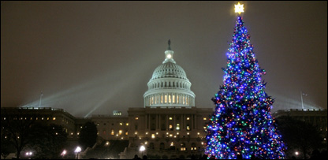
FUTURE
New generation light emitting diodes will wataer purify ,make lights mimic the colour of sunshine and keep private data imuune from hackers.
But now blue LEDs are used everywhere, including the backlighting on mobile phones
Researchers are now trying to convert blue light into ultraviolet.suitable for homes.
Ultraviolet LEDs also have the potential to revolutionise water quality in the developing world.
People could be using it for financial transactions over the internet in the next 10 or 20 years,”

Slide 38


Future Uses for OLED
Lighting
  Flexible / bendable lighting
  Wallpaper lighting defining new ways to light a space
  Transparent lighting doubles as a window
Cell Phones
  Nokia 888

Slide 39

Inside a Light Emitting Diode
Transparent Plastic Case
Terminal Pins
Diode

Slide 40
LIGHTING TECHNOLOGIES:
CATHODE RAY TUBE (CRT)
VACUUM FLOURECENT DISPLAY (VFD)
FIELD EMISSION DISPLAY (FED)
LIQUID CRYSTAL DISPLAY (LCD)
PLASMA DISPLAY PANEL (PDP)
ELECTROLUMINISCENT DISPLAY (EL)
LIGHT EMITTING DIODE (LED)

Slide 41

LIGHTING TECHNOLOGIES:
Cathode-Ray Tubes
Field emission displays, electrons coming from millions of tiny microtips pass through gates and light up pixels on a screen in television sets or in Monitors.

Slide 42

Rear Projection CRT
LIGHTING TECHNOLOGIES:

Slide 43
Violet ~ 3.17eV
Blue ~ 2.73eV
Green ~ 2.52eV
Yellow ~ 2.15eV
Orange ~ 2.08eV
Red ~ 1.62eV

Slide 44



COMPUTER INTERFACE DISPLAYS
SCREENS
MOVING MESSAGE DISPLAYS INDOOR / OUTDOOR
EXCHANGE RATE DISPLAYS
STOCK EXCHANGE RATE DISPLAYS
PLCs
COUNTERS
INDICATORS
SCORE BOARDS
COMPUTER CONTROLLED COUNTERS

Slide 45
COMPUTER INTERFACE DISPLAYS
MAJOR COMPONENTS
LED DISPLAY
CONTROLLER
COMPUTER SOFTWARE
DATA COMMUNICATION THROUGH
  REMOTE CONTROLLER
  COM PORT
  MODEM
  DSL LINE / INTERNET

Slide 46


011010001
MODEM
011010001
INTERNET
MODEM

Slide 47

COMPUTER INTERFACE DISPLAYS
CONTROLLER
Modem
IC integrated Circuit
  a microelectronic computer circuit incorporated into a chip and transistors
Memory IC
  RAM/ROM

Slide 48

COMPUTER INTERFACE DISPLAY
CONTROLLER
IC integrated Circuit
Memory IC
a microelectronic computer circuit incorporated into a chip and transisters;

Slide 49

MATRIX 8x8
1111111111111111100110010001100000011000000110000001100000011000
00000000000000000000000000000000000000000000000000000000000000

Slide 50

Advantages of LEDs
LED Displays Vs. LCD and Plasma
  Much faster response time
  Consume significantly less energy
  Able to display "True Black" picture
  Wider viewing angles
  Thinner display
  Better contrast ratio
  Safer for the environment
  Has potential to be mass produced inexpensively
  LEDs refresh almost 1,000 times faster then LCDs

Slide 51
Advantages of LEDs
LED Lighting Vs. Incandescent and Fluorescent
  Cheaper way to create flexible lighting
  Requires less power
  Better quality of light (ie. no "Cold Light")
  New design concepts for interior lighting

Slide 52
MAIN ADVANTAGES
HIGH RESOLUTION
HIGH BRIGHTNESS
LARGE VIEWING ANGLE
HIGH WRITING SPEEDS
LARGE COLOUR GAMUT
HIGH CONTRAST
LESS WEIGHT AND SIZE
LOW POWER CONSUMPTION
LOW COST

Slide 53

Disadvantages of OLEDs
LED Displays Vs. LCD and Plasma
  Cost to manufacture is high
  Overall luminance degradation
  Constraints with lifespan
  Easily damaged by water
  Limited market availability
LED Lighting Vs. Incandescent and Fluorescent
  Not as easy as changing a light bulb

Slide 54
Reference sites
http://en.wikipedia.org/wiki/Light-emitting_diode
http://tinypic.com/search.php?type=images&tag=led

Slide 55

THANK YOU

